Slide 1
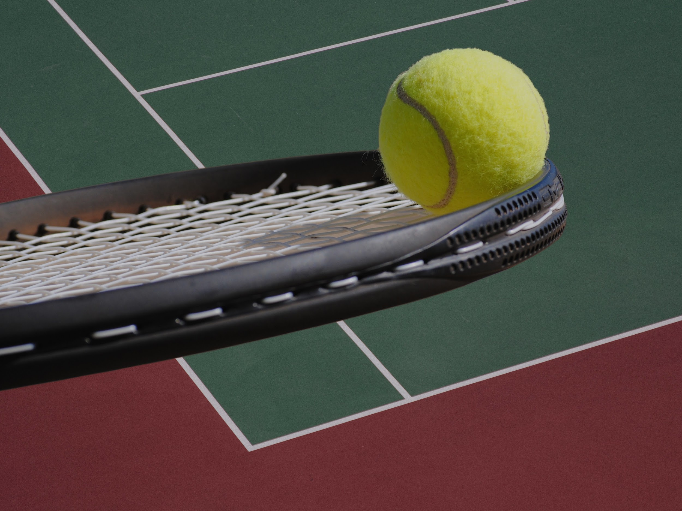

VIBE SHOT
LESS VIBRATION,MAX VIBE🔥
ISHAAN AND MEDHAANSH

Slide 2

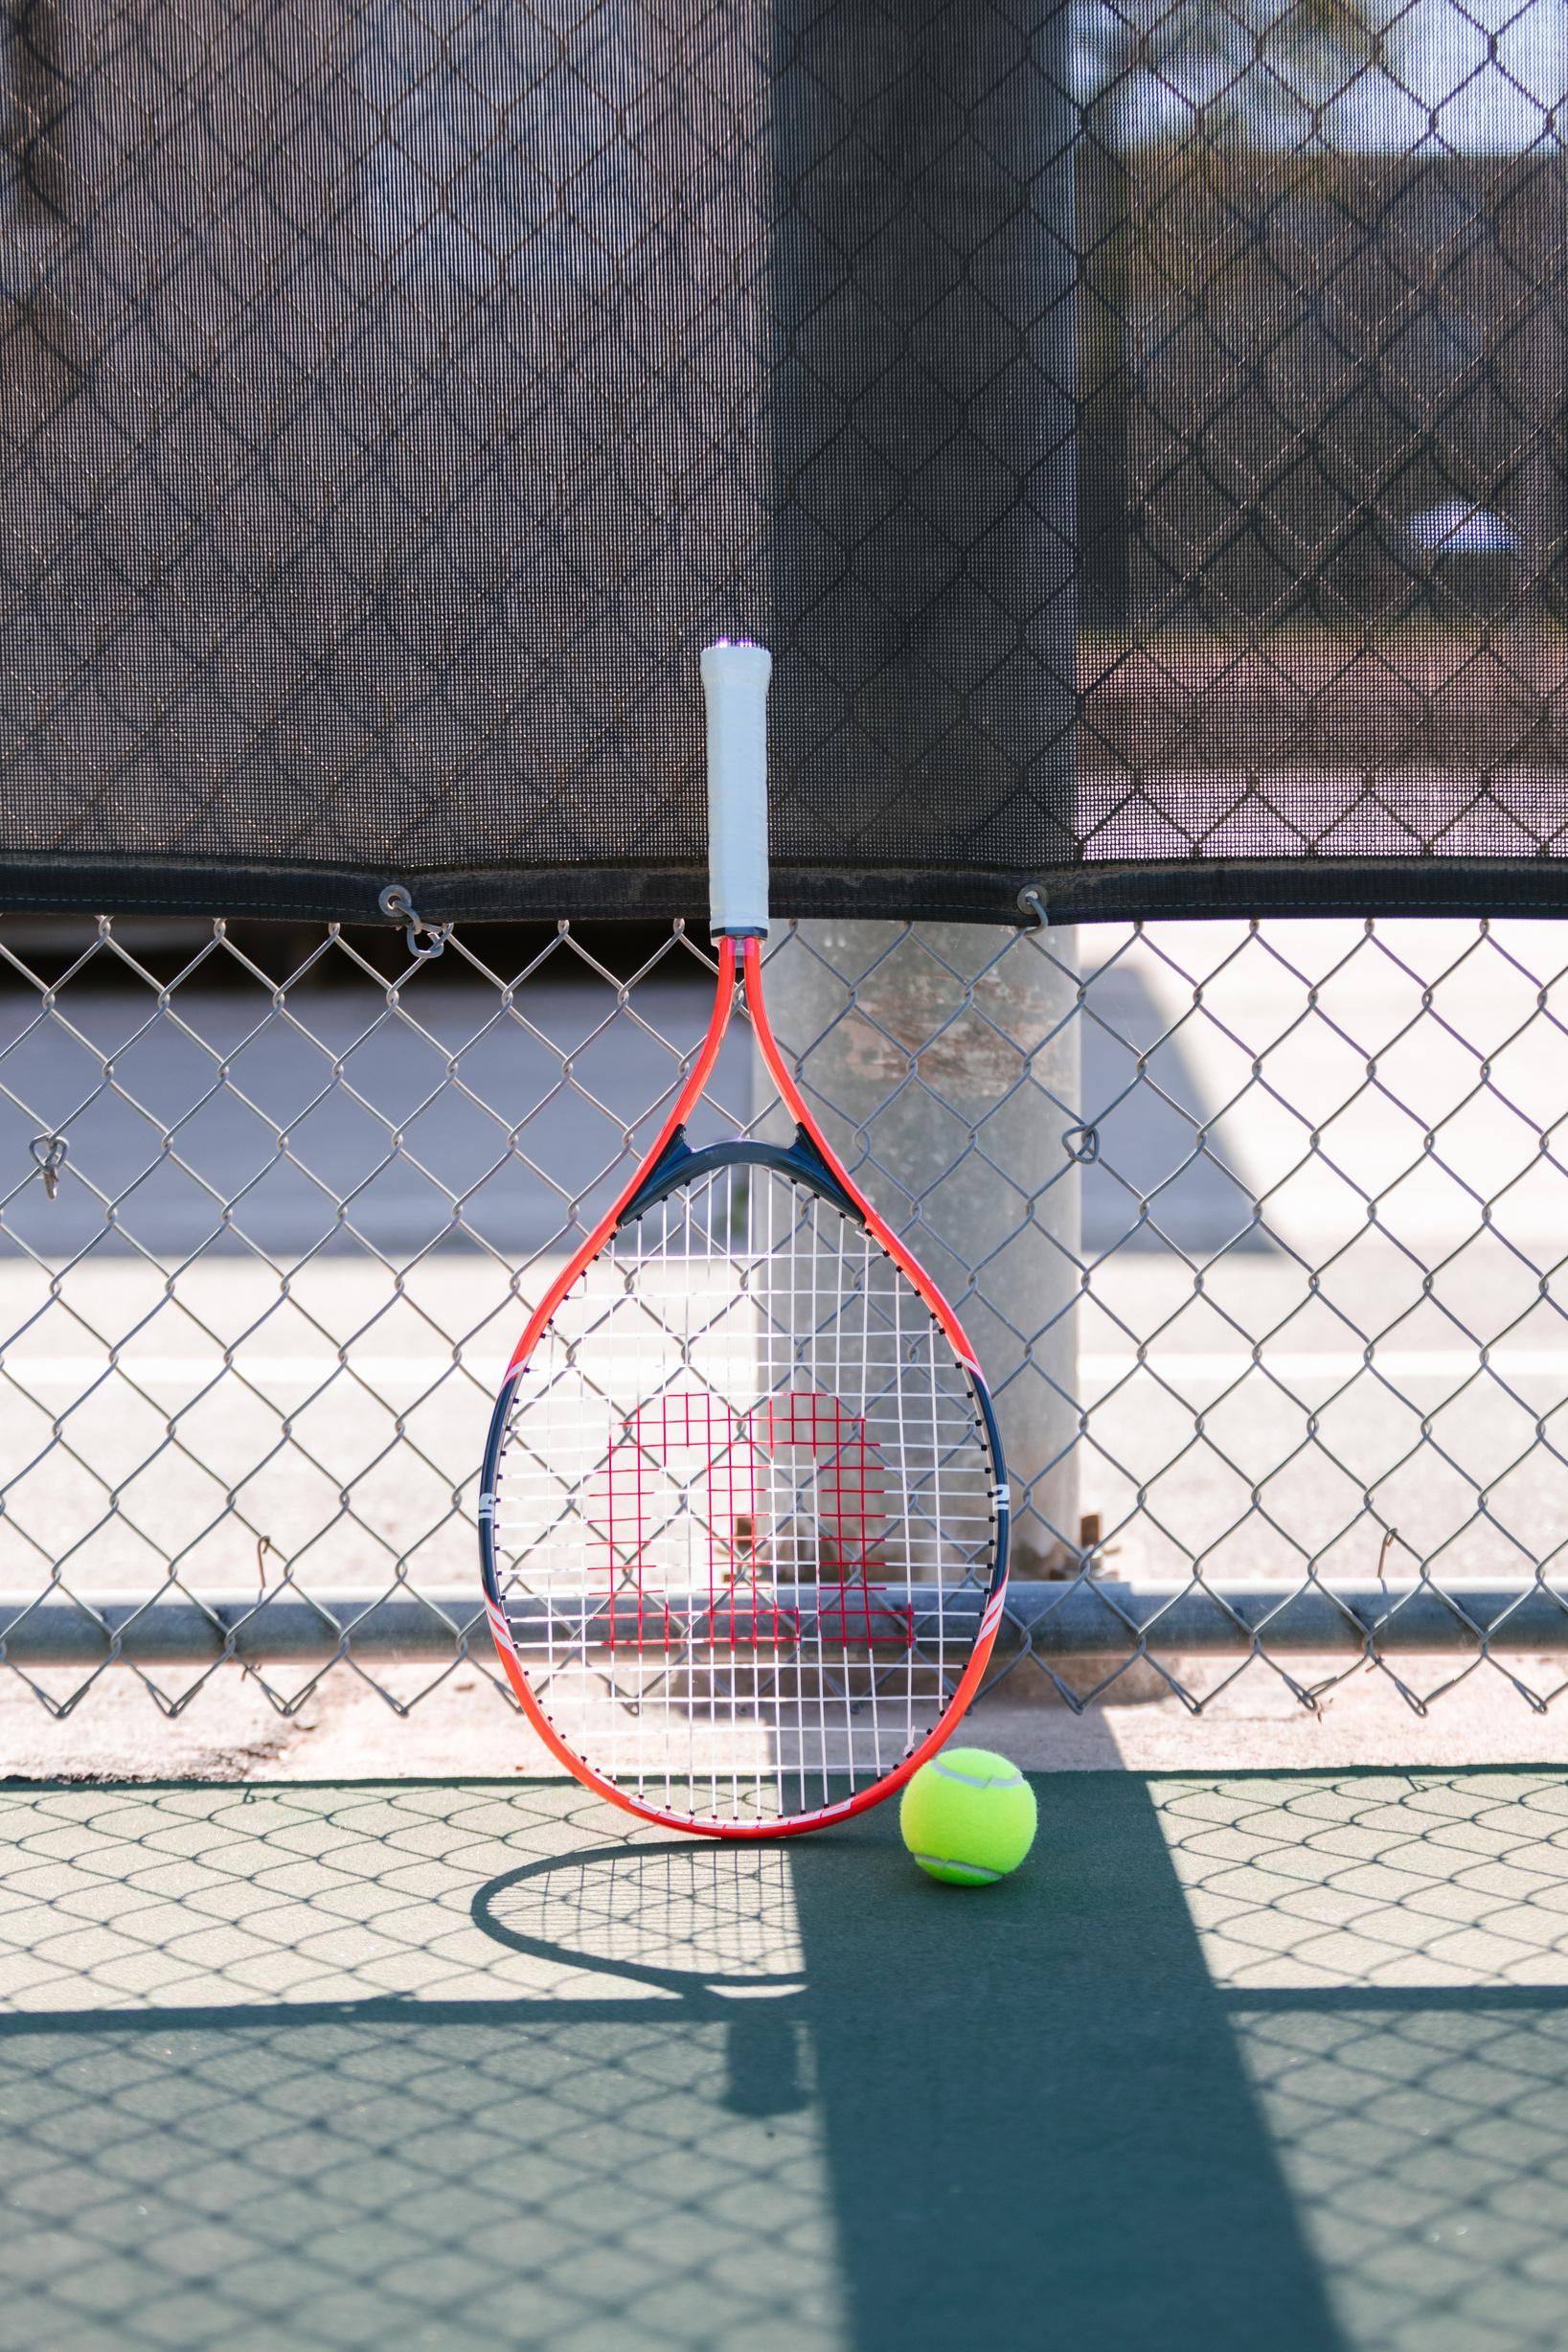
Problem Statement
Title: The Sweet Spot Problem
IN TENNIS, HITTING THE RACKET'S SWEET SPOT IS CRUCIAL FOR POWER, CONTROL, AND AVOIDING INJURIES.
BEGINNERS OFTEN CAN’T TELL IF THEY’VE HIT THE SWEET SPOT—NO FEEDBACK, NO GUIDANCE.
CURRENT METHODS RELY ON VISUAL OBSERVATION, WHICH IS DELAYED AND SUBJECTIVE.
THERE’S NO AFFORDABLE, REAL-TIME SOLUTION TO PROVIDE INSTANT FEEDBACK BASED ON HIT QUALITY.
MISSED HITS ALSO CAUSE UNNECESSARY VIBRATION AND NOISE, INCREASING RISK OF WRIST STRAIN.

Slide 3

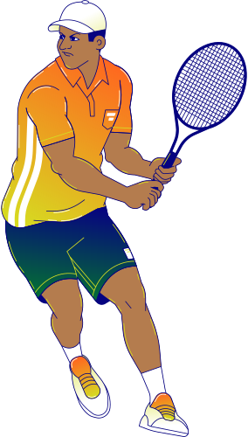

Vibe
check
Meet The Instructor
BRAINSTORMING POST-PRE-RESIDENCY; IDEAS FELT SCATTERED AND THE DEADLINE PRESSURE WAS HIGH.
WANTED A SMART TENNIS SYSTEM—BUT WEREN’T SURE HOW TO IMPLEMENT IT.
AFTER DISCUSSIONS WITH MENTORS AND A LOT OF UNCERTAINTY, WE FINALIZED THE IDEA: VIBE SHOT—A SMART FEEDBACK SYSTEM USING VIBRATION SENSING.

Slide 4
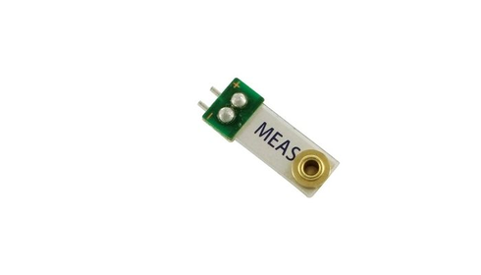
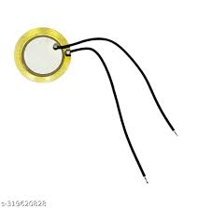


Challenges & Setbacks
Title: The Reality Check#MAKER LIFE
At the asylum, we started with piezo strip sensors to detect vibration—gave inconsistent readings.
Tried multiple tests over first few days—results were unreliable.
Borrowed piezo disc sensor from another team (working on cricket)—showed promise but failed eventually.
Issues: too much external noise, weak signal, sensor quality unreliable.
Momentum dropped—we thought it was over.

Slide 5
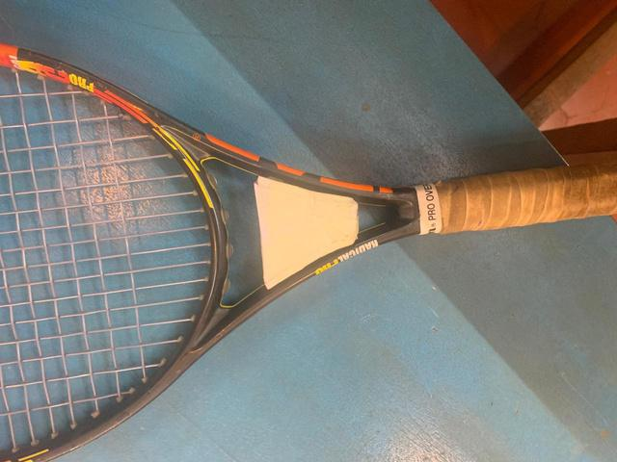
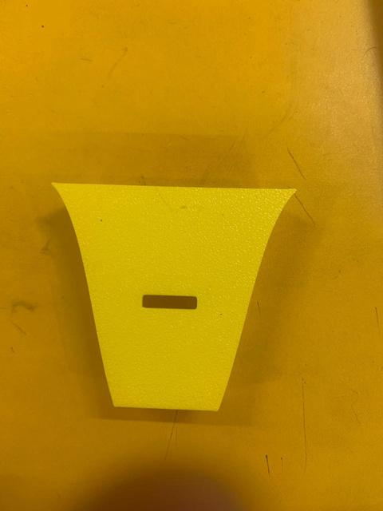
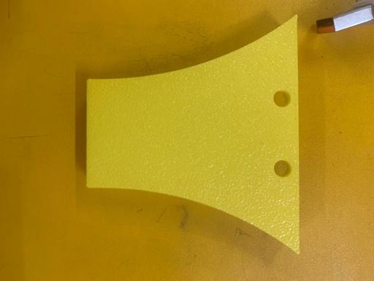
Q1
ACTION
PLAN-MAMBA MENTALITY
Breakthrough & Progress
Title: From Breakdown to Breakthrough .....BUILDING THROUGH AND THROUGH
STAGE:1
VIHAAN FOUND WORKING PIEZO SENSORS FROM OLD INVENTORY AT THE ASYLUM.
READINGS WERE MORE STABLE—PROGRESS BEGAN.
DESIGNED CAD MODELS, BUILT PHYSICAL PROTOTYPES USING:
FOAM (3D PRINTED)
WHITE PAPER MODELO(FOAM)
SIMULTANEOUSLY WORKED ON CODING, FORM STRUCTURE, AND FUNCTIONALITY.
OVERCAME ALL SENSOR AND FEEDBACK ISSUES—WE HAD A WORKING PROTOTYPE
STAGE:2
STAGE:3

Slide 6
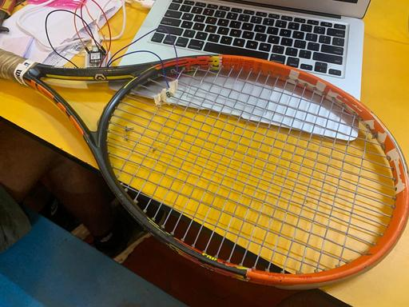

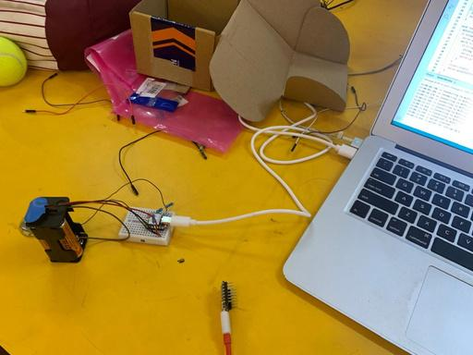
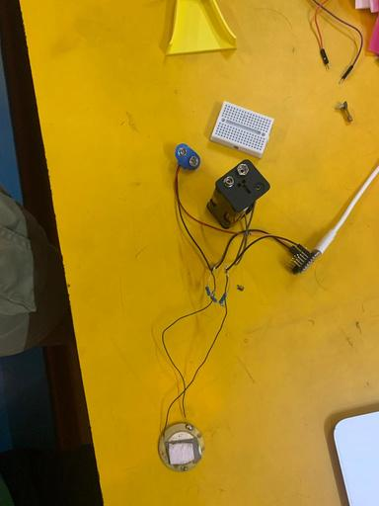
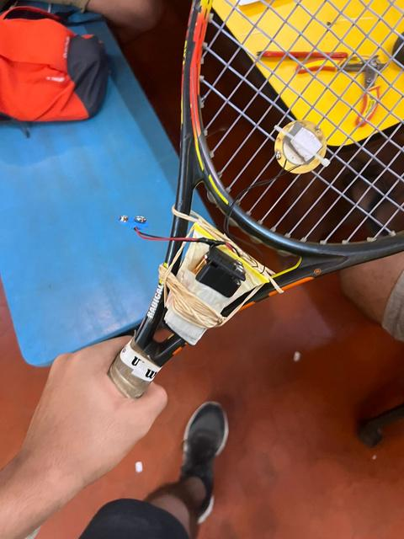
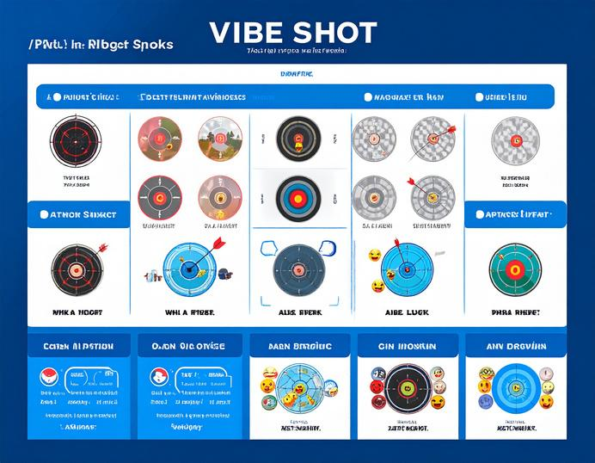

The Final Product
Introducing
VIBE - SHOT
Attachment on a tennis racket that senses vibration using piezo sensors
Detects whether shot hits sweet spot based on vibration intensity thresholds
Sends feedback through serial monitor—helps players identify accuracy zones
Includes a gamified element to make practice more interactive
Low cost, low noise,less vibration and easy to use
Optimal power , efficiency , accuracy , consistency and injury free.
STAGE-4
STAGE-5
STAGE-6
STAGE-7
STAGE-8

Slide 7
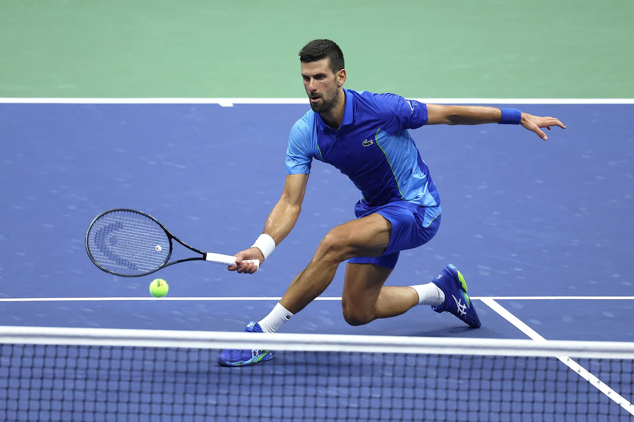

GYAN:
Ready to Play, Ready to Learn
MAKER JOURNEY WASN’T EASY—FACED TECH FAILURES, DEADLINE STRESS, AND MULTIPLE REBUILDS.
BUT WITH TEAMWORK AND PERSISTENCE, WE BUILT SOMETHING WE’RE PROUD OF.
VIBE SHOT MAKES TENNIS TRAINING SMARTER, MORE AFFORDABLE, AND MORE FUN.
READY FOR THE DEMO—AND YOU CAN TRY IT OUT AFTER THE PITCH!

Slide 8


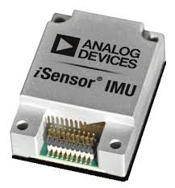
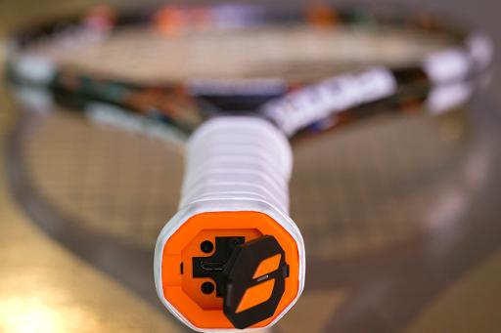
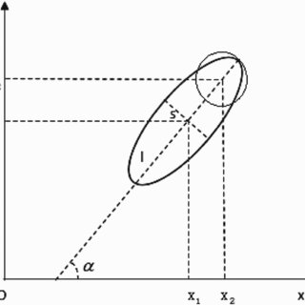
THE WAY FORWARD
PROTOTYPE WITH BETTER MATERIALS ,SENSORS THAT HAVE BETTER QUALITY.LITTLE MORE ADVANCED MATERIALS.
USE IMU-SENSORS WITH ACCELEROMETERS,GYROSCOPES WHICH CAN PROVIDE A LOT OF DATA AND STATS.DETECTS VIBRATION AT MULTIPLE POINTS.
CAN TRIANGULATE THE IMPACT LOCATION USING ACCELERATION DATA.
EMBEDD EVERYTHING INTO HANDLE OF THE RACKET DURING THE PROCESS OF MANUFACTURING BY REDUCING THE WEIGHT OF THE RACKET AND BALANCING IT.
USE A COUPLE OF SENSORS AND NOT JUST ONE TO FIND THE EXACT POINT OF CONTACT OF THE BALL WITH THE RACKET-DETECT IT MORE ACCURATELY RATHER THAN THRESHOLDS. CAN TRIANGULATE IMPACT BASED ON TIME DIFFERENCE

Slide 9



THE BEGINNING
MAKER FOR LIFE

